Slide 1
Infosys Internship – Progress Summary
(October 14 – October 30, 2025)
PROJECT:BUDGETWISE-AI-BASED EXPENSE FORECASTING TOOL
DURATION:(OCTOBER 14-OCTOBER 30,2025)
PREPARED BY:GORLE AJAY

Slide 2
TOPICS LEARNT DURING THE INTERNSHIP PERIOD
Overview of AIML and Their Applications
NumPy (Numerical Python)
PANDAS
Matplotlib
SeaBorn

Slide 3
Overview of AIML and Their Applications
Inventor of Artificial Intelligence:
The term "Artificial Intelligence" was first coined by John McCarthy in 1956
He is often called the “Father of Artificial Intelligence”
John McCarthy defined AI as:
“The science and engineering of making intelligent machines, especially intelligent computer programs.”
Objective of AI:
To create systems that can think, learn, reason, and act like humans.
AI aims to replicate human intelligence in machines.
Applications of Artificial Intelligence:
Healthcare:
AI helps doctors detect diseases early (like cancer or diabetes) using medical images and predictive analytics.
Chatbots assist patients with symptoms and appointment scheduling.
Finance & Banking:
AI detects fraudulent transactions and improves customer service through virtual assistants.
It’s also used for stock market predictions and credit scoring.

Slide 4
Transportation:
Self-driving cars use AI for navigation, object detection, and decision-making.
AI also helps optimize traffic management and logistics.
E-commerce:
Websites like Amazon and Flipkart use AI for product recommendations, dynamic pricing, and customer support chatbots.
Agriculture:
AI-powered drones monitor crops, predict yield, and detect pest infections early
Entertainment:
AI powers content recommendations on platforms like Netflix, YouTube, and Spotify.
It’s also used in video game development for realistic NPC (non-player character) behavior
Smart Assistants:
Devices like Alexa, Siri, and Google Assistant use AI for speech recognition and natural language understanding.
Education:
AI-based tools personalize learning experiences and help automate grading and feedback.

Slide 5
Inventor of Machine Learning:
The term “Machine Learning” was first coined by Arthur Samuel in 1959.
He was a pioneer in computer gaming and artificial intelligence
Arthur Samuel defined Machine Learning as:
“The field of study that gives computers the ability to learn without being explicitly programmed.”
ML is a subset of AI that focuses on enabling systems to learn from data and improve their performance
overtime.
It uses algorithm that identify patterns and relationships in data to make predictions or decisions
Applications of Machine Learning:
Finance:
Used in fraud detection, loan risk assessment, and algorithmic trading
Speech and Image Recognition:
ML powers systems like Google Lens, Face Unlock, and voice assistants.
Autonomous Vehicles:
ML helps self-driving cars detect objects, pedestrians, and traffic signs to make driving decisions.

Slide 6
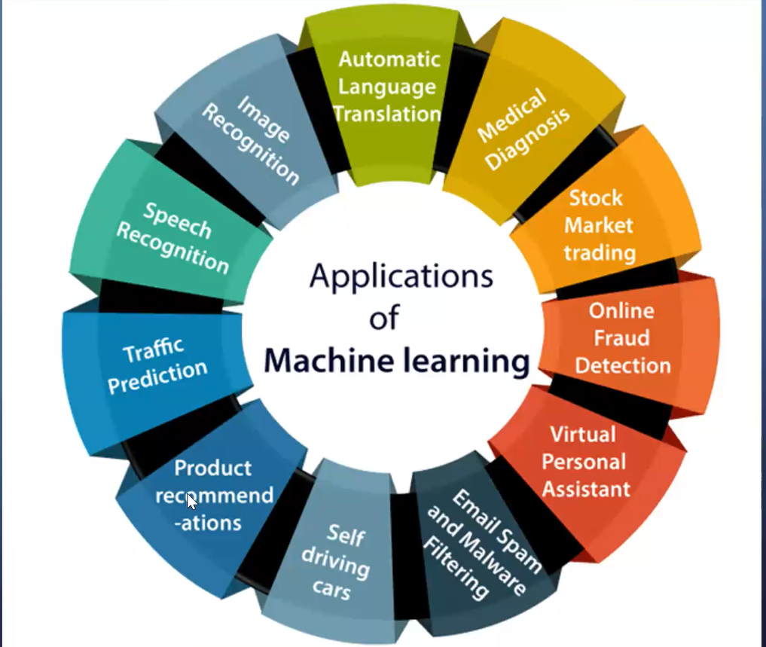

Slide 7
Machine Learning Life Cycle:
Definition:
The Machine Learning Life Cycle is the step-by-step process of developing, training, and deploying a machine learning model from data collection to performance improvement.
Stages of the ML Life Cycle:
1.Data Collection
The first and most crucial stage.
Data is gathered from various sources such as databases, sensors, files, or online repositories.
The quality and quantity of data directly affect model performance.
2. Data Preprocessing
Raw data is often incomplete, noisy, or inconsistent.
Preprocessing involves:
  Cleaning (handling missing values)
  Normalization (scaling values)
  Encoding (converting text to numbers)
The goal is to make the data ready for model training.

Slide 8
3. Feature Engineering
Selecting the most important variables (features) that influence the output.
May also involve creating new features to improve model accuracy.
4. Model Selection
Choosing the best algorithm (like Linear Regression, Decision Trees, etc.) based on the problem — classification, regression, or clustering.
5. Model Training
Feeding the preprocessed data into the model so it can learn patterns.
The model adjusts its parameters to minimize prediction error.
6. Model Evaluation
The trained model is tested using evaluation metrics like:
  Accuracy
  Precision
  Recall
  F1 Score
The performance is compared with expected results.
7. Model Deployment
The final model is integrated into a real-world application to make predictions on live data.

Slide 9
Machine Learning – Key Definitions
Algorithm:
A set of rules and statistical techniques used to learn patterns from data.
Model:
A model is trained using a Machine Learning algorithm to make predictions or decisions.
Predictor Variable (Feature):
It is the feature(s) of the data that can be used to predict the output.
Predictor Variable (Feature):
It is the feature(s) of the data that can be used to predict the output.
Training Data:
The Machine Learning model is built using the training dataset.
Testing Data:
The Machine Learning model is evaluated using the testing dataset.

Slide 10
NumPy (Numerical Python)
Introduction
NumPy stands for Numerical Python.
NumPy is an open-source Python library used for scientific and numerical computing.
NumPy provides support for large, multi-dimensional arrays and matrices, along with a collection of mathematical functions to operate on these arrays efficiently
It forms the foundation for most data science and machine learning libraries, including Pandas, TensorFlow, and Scikit-learn.
Real-Life Applications of NumPy
Data Analysis: Handles large numerical datasets efficiently.
Machine Learning: Used for preprocessing, normalization, and mathematical computations.
Image Processing: Used in operations like resizing, filtering, and color conversions.
Signal Processing: Useful in audio and wave analysis.
Scientific Computing: Performs matrix and linear algebra operations quickly.

Slide 11
Working with NumPy in Python:
#Creating Arrays using NumPy
import numpy as np #Imports the NumPy library and gives it the alias np for convenience.
arr1 = np.array([1, 2, 3, 4, 5]) #Creating a 1D array , np.array( )→ Converts a Python list into a NumPy array.
arr2 = np.array([[1, 2, 3], [4, 5, 6]]) #Creating a 2D array
print("1D Array:", arr1)
print("2D Array:\n", arr2)
OUTPUT:
1D Array: [1 2 3 4 5]
2D Array:
[[1 2 3]
[4 5 6]]
#Initializing Numpy array with random numbers
Import numpy as np
n1=np.random.randit(1,100,5) #np.random.randint() -This function generates random integers
n1 within a specified range
OUTPUT:array([95,88,26,22,76])

Slide 12
# Column Stacking in NumPy
import numpy as np
a = np.array([1, 2, 3])
b = np.array([4, 5, 6])
result = np.column_stack((a, b)) #np.column_stack((a,b))-combines the arrays as columns to form a print(result) 2darray
OUTPUT:
[[1 4]
[2 5]
[3 6]]
#Joining NumPy array vstack(),hstack()
import numpy as np
arr1 = np.array([1, 2, 3])
arr2 = np.array([4, 5, 6])
v = np.vstack((arr1, arr2)) #Joins the arrays vertically (row-wise)
h = np.hstack((arr1, arr2)) #Joins the arrays horizontally (column-wise)
print("Vertical Stack:\n", v)
print("Horizontal Stack:\n", h)

Slide 13
OUTPUT:
Vertical Stack:
[[1 2 3]
[4 5 6]]
Horizontal Stack:
[1 2 3 4 5 6]
#Finding the Shape of an Array using NumPy
import numpy as np
arr = np.array([[1, 2, 3],
[4, 5, 6]])
print("Shape of the array:", arr.shape) #Returns a tuple representing the dimensions of the array
OUTPUT:Shape of the array: (2, 3)
#Initializing NumPy with zeroes
Import numpy as np
n1=np.zeroes((1,2))
n1
OUTPUT:array([[0.,0.]])

Slide 14
#INITIALIZING NumPy ARRAY WITH SAME NUMBER
Import numpy as np
n1=np.full((2,2),10)
n1
OUTPUT:array([10,10],
[10,10]])
#INITIALIZING NumPy ARRAY WITHIN A RAGE
Import numpy as np
n1=np.arrange(10,50,5)
n1
OUTPUT:array([10,15,20,25,30,35,40,45])
#NumPy INSERTION
import numpy as np
n1=np.array([10,20,30,40,50,60])
n2=np.array([50,60,70,80,90])
np.intersect1d(n1,n2)
OUTPUT:array([50,60])

Slide 15
#NumPy DIFFERENCE
import numpy as np
n1=np.array([10,20,30,40,50,60])
n2=np.array([50,60,70,80,90])
np.setdiff1d(n1,n2)
OUTPUT:array([10,20,30,40])
#NumPy ADDITION
import numpy as np
n1=np.array([10,20])
n2=np.array([30,40])
np.sum([n1,n2])
OUTPUT:100
np.sum([n1,n2],axis=0)
OUTPUT:array([40,60])
np.sum([n1,n2],axis=1)
OUTPUT:array([30,70])

Slide 16
#NumPy Array Mathematics:
BASIC ADDITION
Import numpy as np
N1=np.array([10,20,30])
n1=n1+1
N1
OUTPUT:array([11,21,31])
BASIC MULTIPLICATION
import numpy as np
n1=np.array([10,20,30])
n1=n1*2
n1
OUTPUT:array([20,40,60])
BASIC SUBTRACTION
import numpy as np
n1=np.array([10,20,30])
n1=n1-1
n1
OUTPUT:array([9,19,29])

Slide 17
BASIC DIVISION
import numpy as np
n1=np.array([10,20,30])
n1=n1/2
n1
OUTPUT:array([5.,10.,15.])
MEAN
import numpy as np
n1=np.array([10,20,30,40,50,60])
np.mean(n1)
OUTPUT:35.0
STANDARD DEVIATION
import numpy as np
n1=np.array([1,5,3,100,4,48])
np.std(n1)
OUTPUT:36.59424666377065

Slide 18
#NumPy Matrix
MATRIX REPRESENTATION&BASIC OPERATIONS
import numpy as np
n1=np.array([[1,2,3].[4,5,6],[7,8,9]])
n1
OUTPUT: array([1,2,3],
[4,5,6],
[7,8,9]])
import numpy as np
n1=np.array([[1,2,3].[4,5,6],[7,8,9]])
n1[0]
OUTPUT: array([1,2,3])
import numpy as np
n1=np.array([[1,2,3].[4,5,6],[7,8,9]])
n1[1]
OUTPUT: array([4,5,6])

Slide 19
TRANSPOSE OF A MATRIX
import numpy as np
n1=np.array([[1,2,3].[4,5,6],[7,8,9]])
n1.transpose()
OUTPUT: array([1,4,7],
[2,5,8],
[3,6,9]]
MATRIX MULTIPLICATION
import numpy as np
n1=np.array([[1,2,3],[4,5,6],[7,8,9]])
n2=np.array([[9,8,7],[6,5,4],[3,2,1]])
n1.dot(n2)
OUTPUT: array([[30,24,18],
[84,69,54],
[138,114,90]])

Slide 20
PANDAS
Introduction
Pandas is an open-source Python library used for data analysis and data manipulation
It helps to handle structured data like tables (rows and columns) easily
It is widely used in Machine Learning, Data Science, and AI projects
It provides two main data structures:
Series – for one-dimensional data
DataFrame – for two-dimensional data
Changing index in series(for one dimensional data)
import pandas as pd
s1=pd.Series([1,2,3,4,5])
s1
OUTPUT:0 1
1 2
2 3
3 4
4 5
dtype: int64

Slide 21
CHANGING THE INDEX
import pandas as pd
s1 = pd.Series([1, 2, 3, 4, 5], index=['A', 'B', 'C', 'D', 'E’])
print(s1)
OUTPUT: A 1
B 2
C 3
D 4
E 5
dtype: int64
SERIES OBJECT FROM DICTIONARY
import pandas as pd
data = {'A': 10, 'B': 20, 'C': 30}
s = pd.Series(data)
print(s)
OUTPUT: A 10
B 20
C 30
dtype: int64

Slide 22
CHANGING INDEX POSITION
import pandas as pd
data = [10, 20, 30, 40, 50]
s = pd.Series(data, index=['A', 'B', 'C', 'D', 'E'])
print("Original Series:\n", s)
s = s.reindex(['C', 'A', 'E', 'B', 'D'])
print("\nSeries After Changing Index Positions:\n", s)
OUTPUT:Original Series:
A 10
B 20
C 30
D 40
E 50
dtype: int64
Series After Changing Index Positions:
C 30
A 10
E 50
B 20
D 40
dtype: int64

Slide 23
EXTRACTING ELEMENTS FROM SERIES
import pandas as pd
s1=pd.Series([1,2,3,4,5,6,7,8,9])
s1[3] #extracting a single element
OUTPUT:4
import pandas as pd
S1=pd,series([1,2,3,4,5,6,7,8,9])
S1[-3:] #extracting element from back
OUTPUT:6 7
7 8
8 9
dtype: int64
import pandas as pd
S1=pd,series([1,2,3,4,5,6,7,8,9])
S1[ :4] #extracting a sequence of elements
OUTPUT:0 1
1 2
2 3
3 4

Slide 24
Pandas DataFrame
import pandas as pd
data = {'Name': ['Ajay', 'Ravi', 'Kiran'],
'Age': [19, 20, 21],
'Course': ['CSE', 'ECE', 'AIML']}
df = pd.DataFrame(data)
print(df)
OUTPUT: Name Age Course
0 Ajay 19 CSE
1 Ravi 20 ECE
2 Kiran 21 AIML
COMMON INBUILT FUNCTIONS:
df.head()--Returns the first 5 rows of the DataFrame
df.tail()--Returns the last 5 rows of the DataFrame
df.describe()--Gives statistical summary of numeric columns (count, mean, min, max, etc.)
df.shape--Returns the (rows, columns) of the DataFrame as a tuple
LET US IMPORT A DATA SET AND TRY THESE(IMPORTING DATASET FROM KAGGLE)

Slide 25
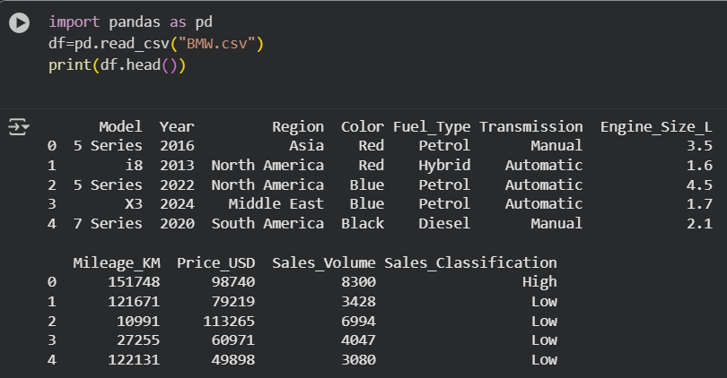
IMPORTED THE DATASET OF BMW CAR SALES FROM 2010-2024
Using df.head()--Returns the first 5 rows of the DataFrame

Slide 26
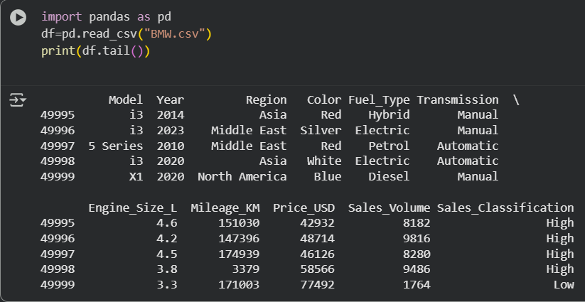
Using df.tail()--Returns the last 5 rows of the DataFrame

Slide 27
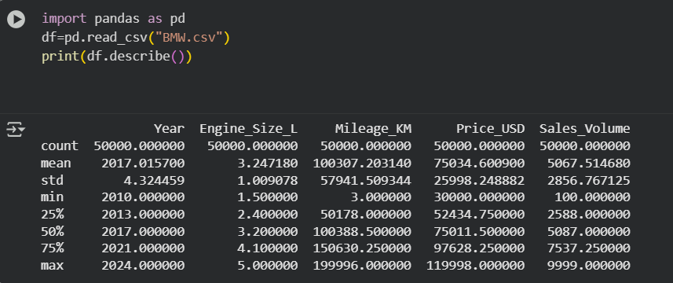
Using df.describe()--Gives statistical summary of numeric columns (count, mean, min, max, etc.)

Slide 28
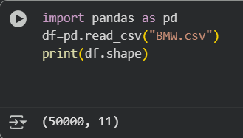
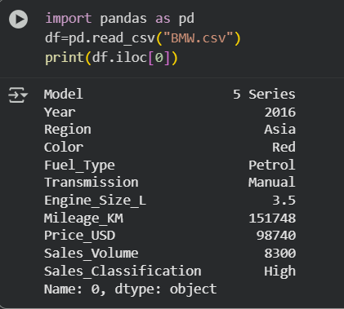
Using df.shape--Returns the (rows, columns) of the DataFrame as a tuple
ILOC AND LOC
ILOC:-Index-based selection
It is used to access rows and columns by their integer positions (like array indexes)
df.iloc[0] # First row
df.iloc[1, 0] # Row 1, Column 0 (Ravi)
df.iloc[:, 1] # All rows, only column 1 (Age)
df.iloc[0:2, :] # First two rows, all columns

Slide 29
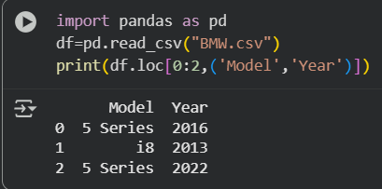
LOC:-Label-based selection
It is used to access data by row and column names (labels), not by position
df.loc[0] # Access row with label 0
df.loc[:, ‘Year'] # All rows, only ‘Year' column
df.loc[1, ‘Model'] # Value at row 1, column ‘Model'
df.loc[0:2, [‘Year']] # Rows 0 to 2, only ‘Year' column

Slide 30
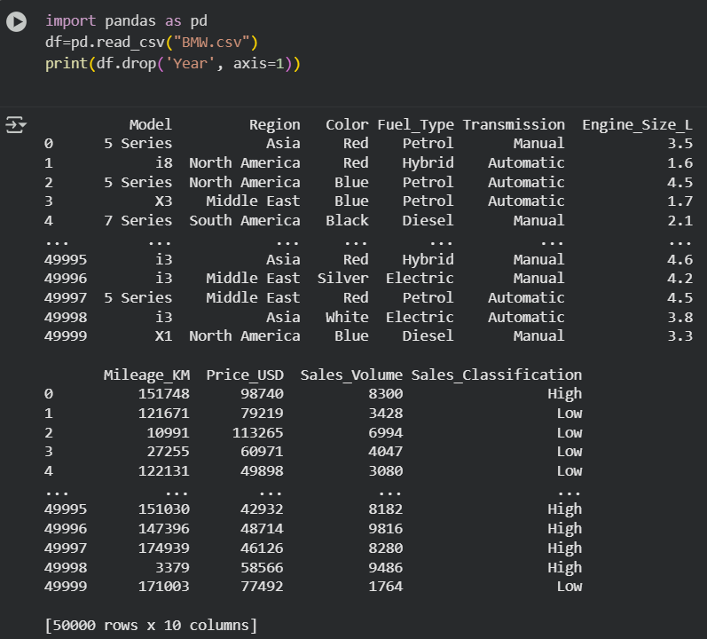
Dropping Columns:

Slide 31
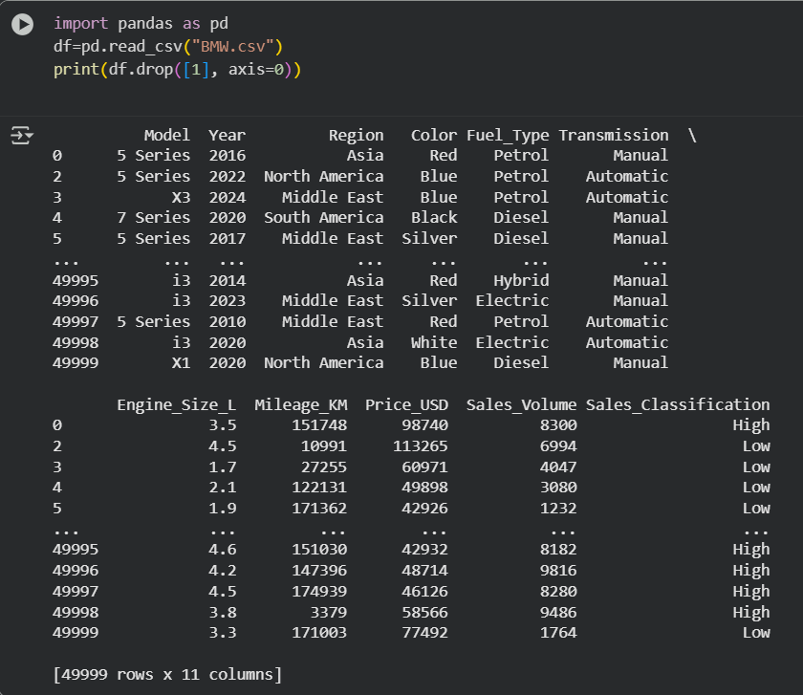
Dropping Rows

Slide 32
MATPLOTLIB
Matplotlib is a Python library used to create visualizations such as graphs, charts, and plots to better understand data
the module matplotlib.pyplot is the most commonly used part
Uses of Matplotlib
Display data visually in the form of graphs.
Compare multiple datasets.
Detect patterns and anomalies in data.
Represent machine learning results effectively.
COMMON TYPES OF PLOTS
PLOT TYPE FUNCTION
Line plot plt.plot()
Bar plot plt.bar()
Scatter plot plt.scatter()
Histogram plt.hist()
Box plot plt.boxplot()
Violin plot plt.violinplot()

Slide 33
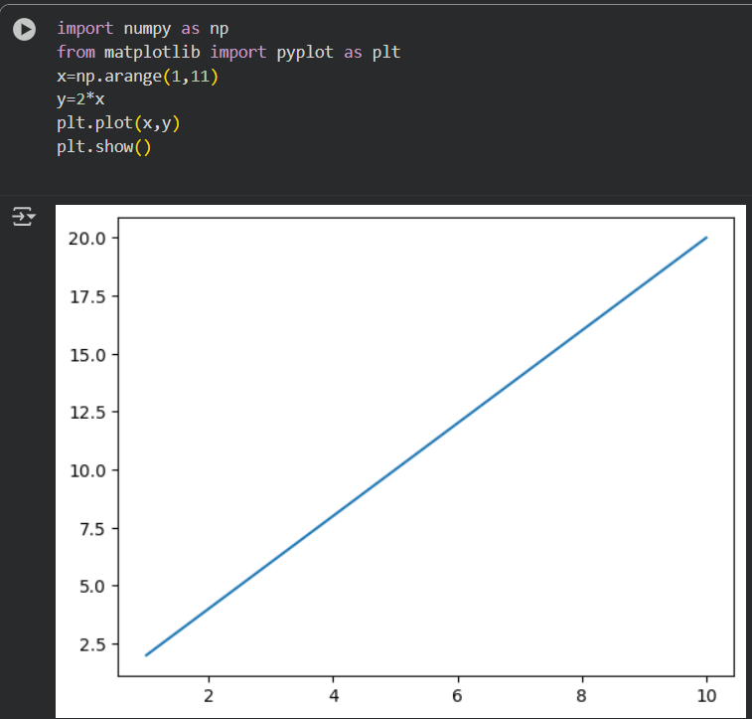
LINE PLOT
A line plot is used to display data points connected by straight lines.
It helps to show trends, patterns, or changes in data over a continuous period

Slide 34
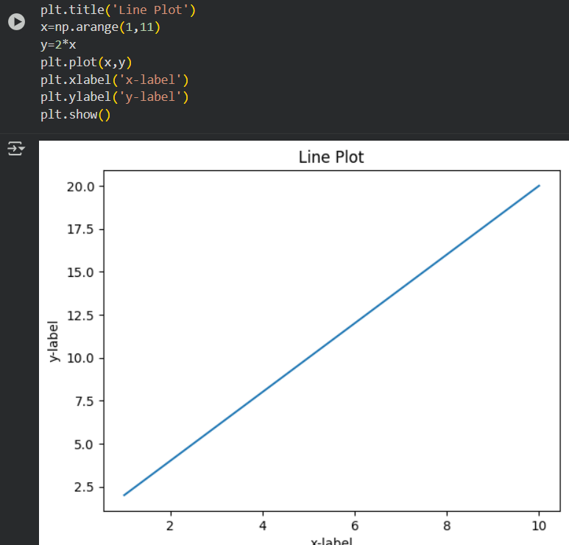
LINE PLOT WITH TITLE AND LABELS

Slide 35
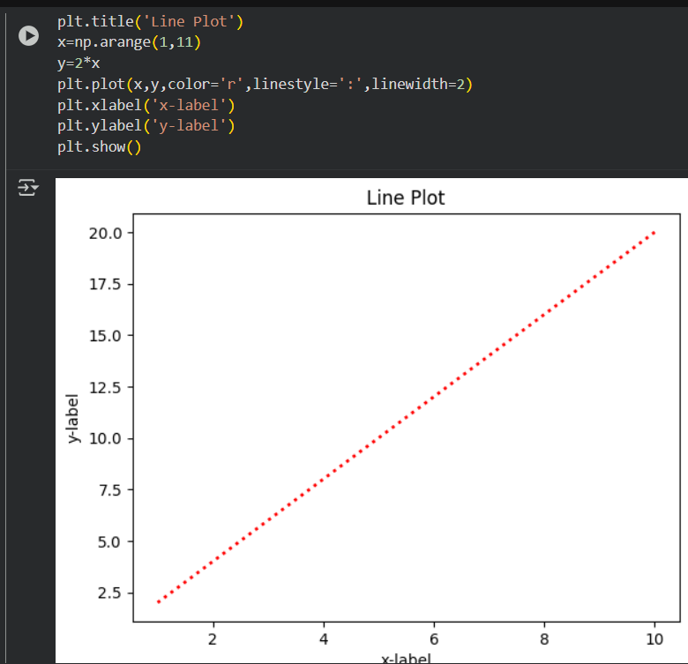
CHANGING LINE ASTHETICS
SAME TYPE OF PLOT AS THE BEFORE ONE WITH SOME LINE CHARACTERS INCLUDED

Slide 36
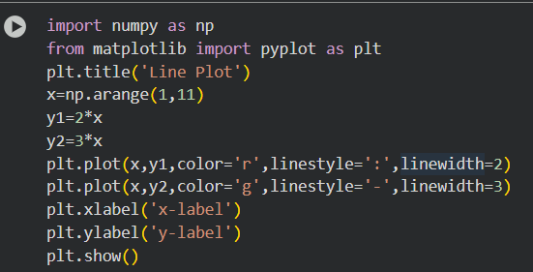
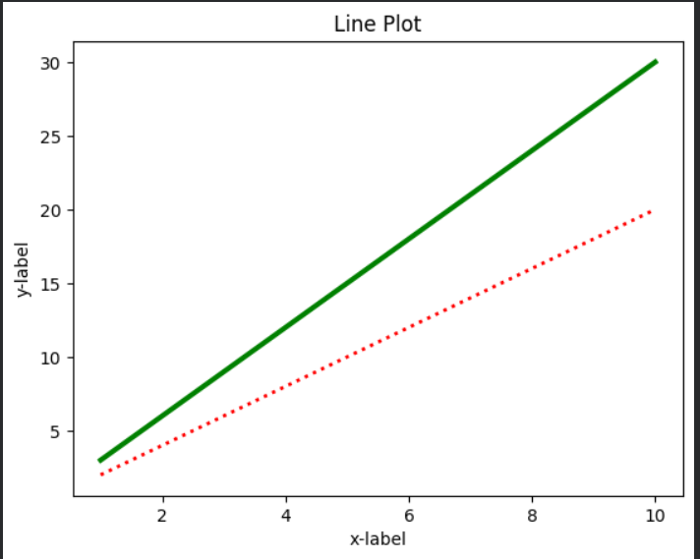
Plotting Multiple Lines in a Single Graph

Slide 37
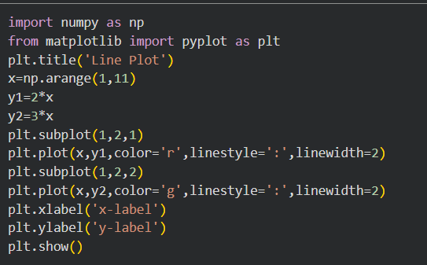
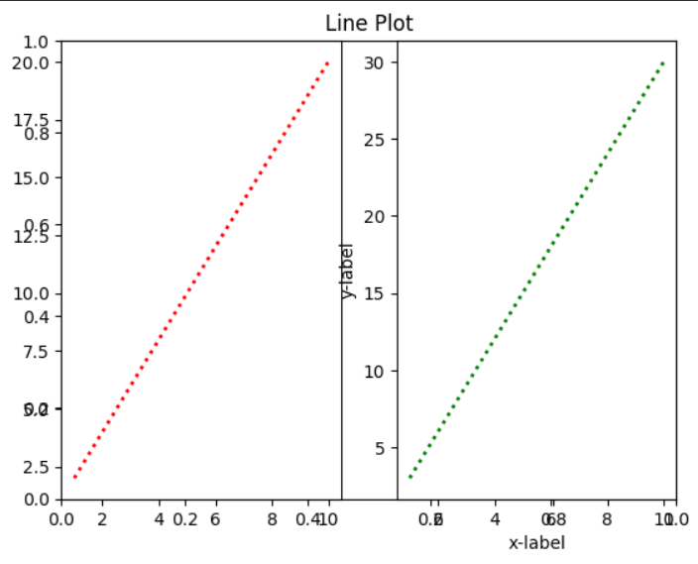
ADDING SUBPLOTS TO LINE PLOT

Slide 38
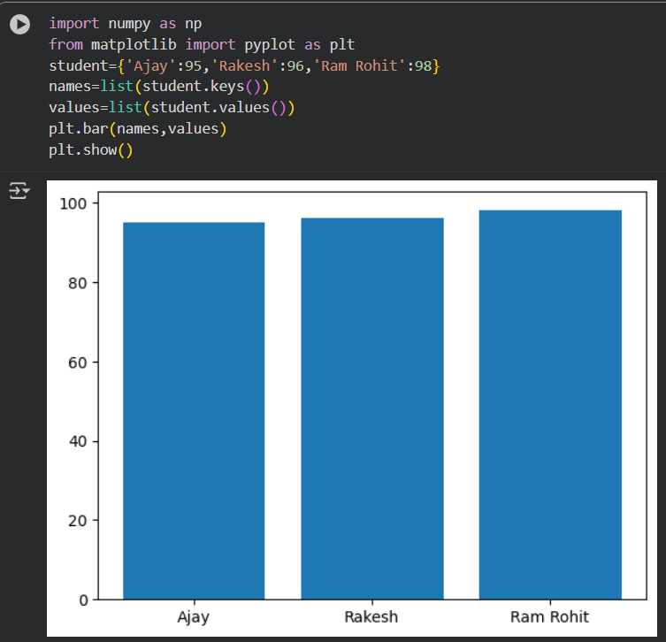
BAR PLOT
A bar plot is used to represent categorical data with rectangular bars.
The length or height of each bar corresponds to the value it represents.

Slide 39
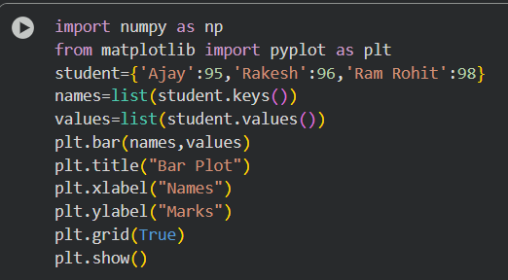
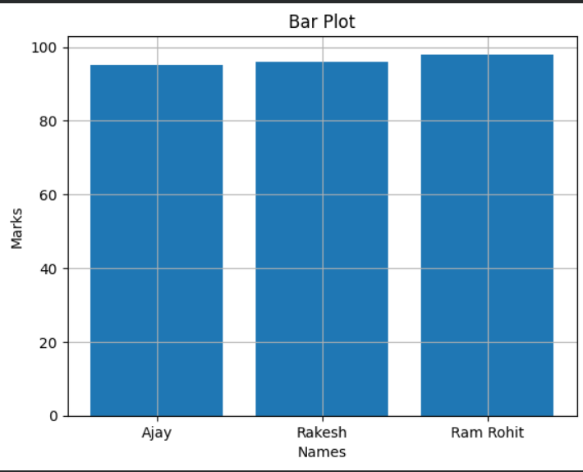
BAR PLOT WITH TITLE AND LABELS

Slide 40
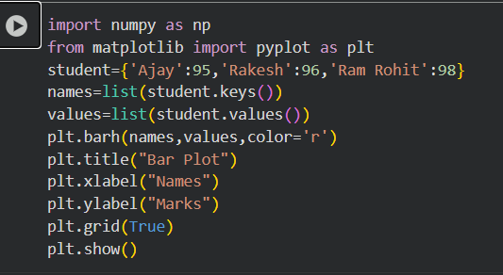
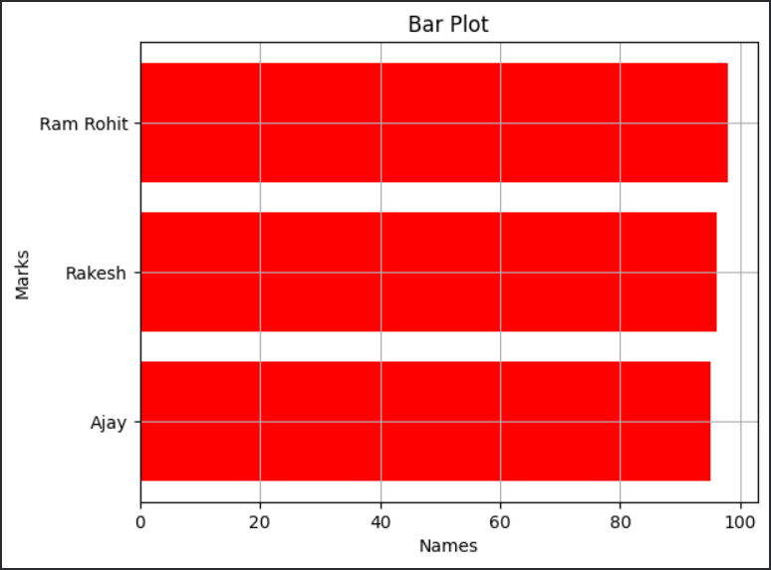
HORIZONTAL BAR PLOT

Slide 41
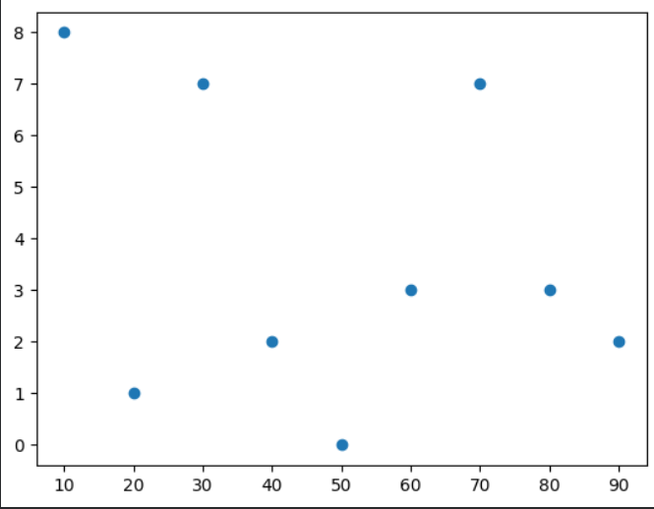
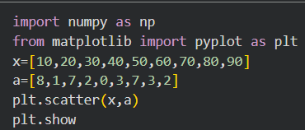
SCATTER PLOT
A scatter plot is used to display the relationship between two numerical variables by showing data points on a two-dimensional plane
BASIC SCATTER PLOT

Slide 42
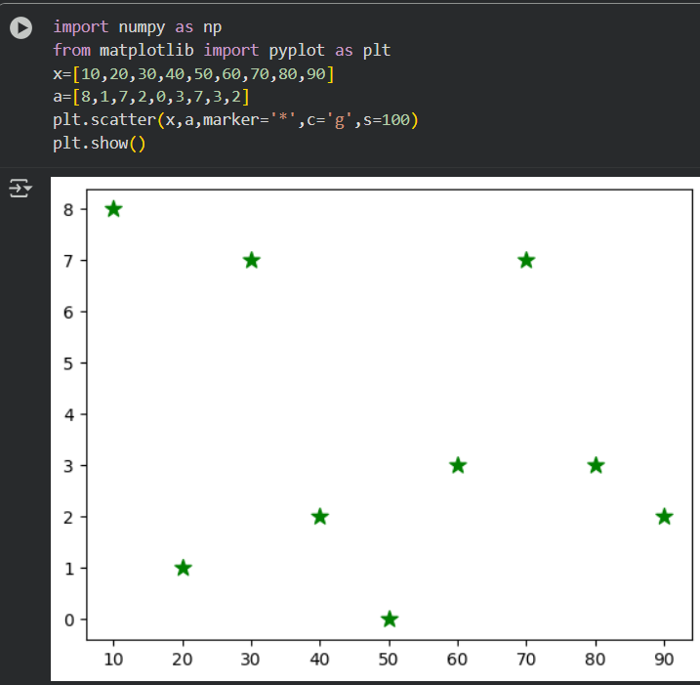
CHANGING MARK ASTHETICS

Slide 43
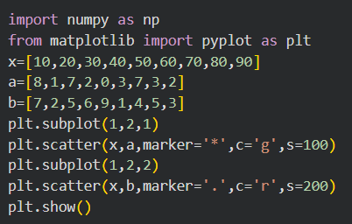
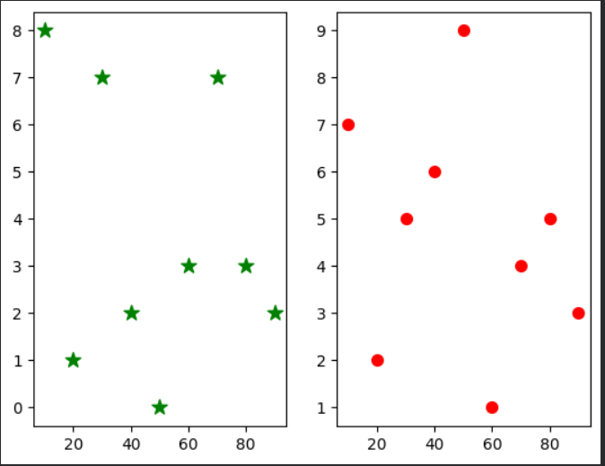
ADDING SUBPLOTS TO SCATTER PLOT

Slide 44
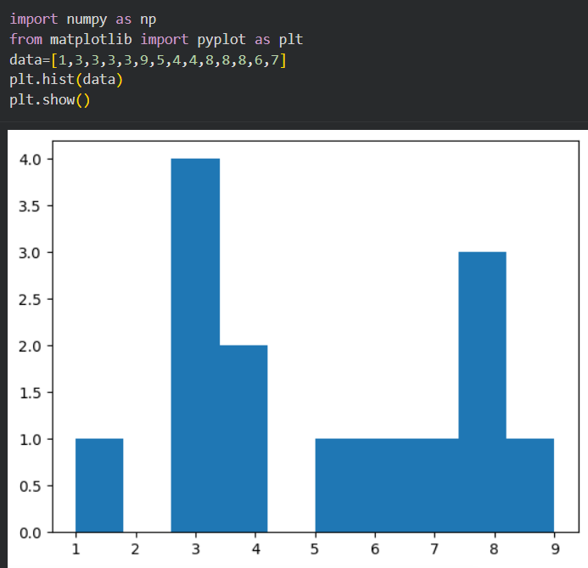
HISTOGRAM
A histogram is used to show the distribution of a continuous numerical variable.
It divides the entire range of values into intervals (bins) and counts how many values fall into each bin

Slide 45
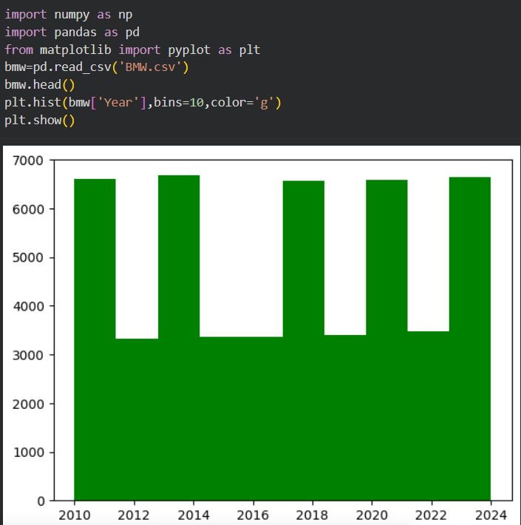
HISTOGRAM WITH DATASET

Slide 46
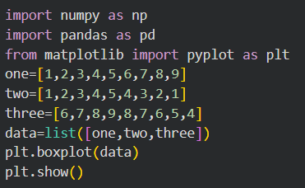
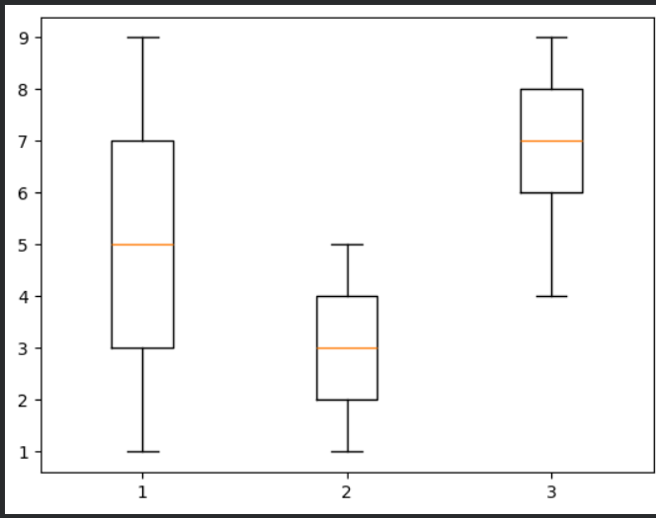
BOX PLOT
A Box Plot (also known as a Box-and-Whisker Plot) is used to display the spread and skewness of numerical data

Slide 47
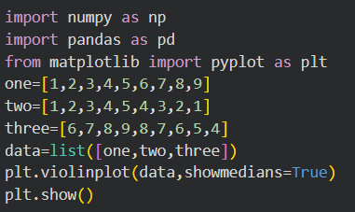
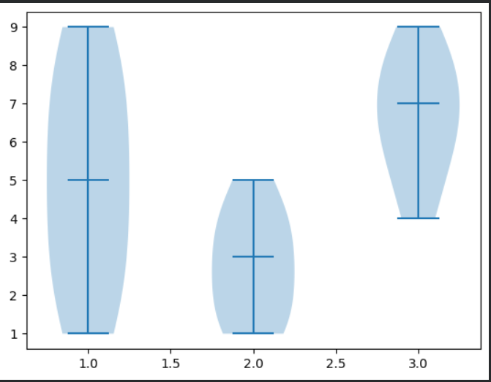
VIOLIN PLOT

Slide 48
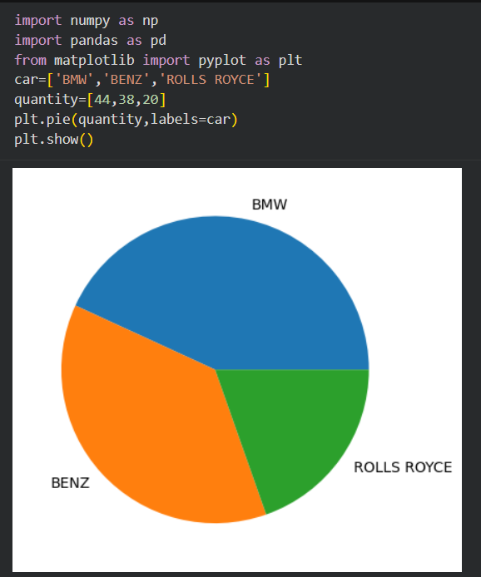
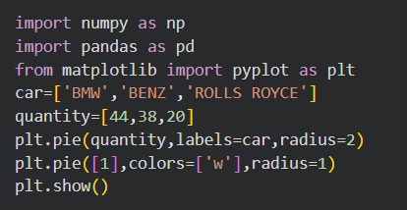
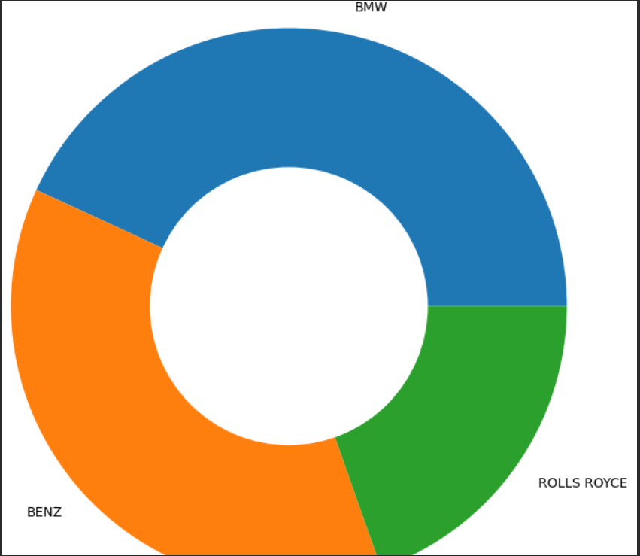
PIE CHART
DOUGHNUT CHART

Slide 49
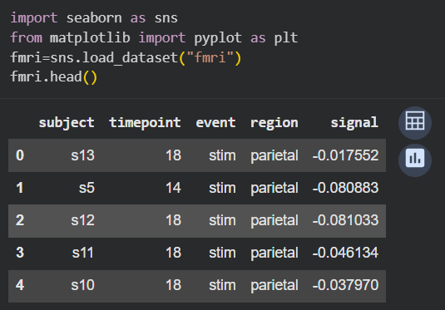
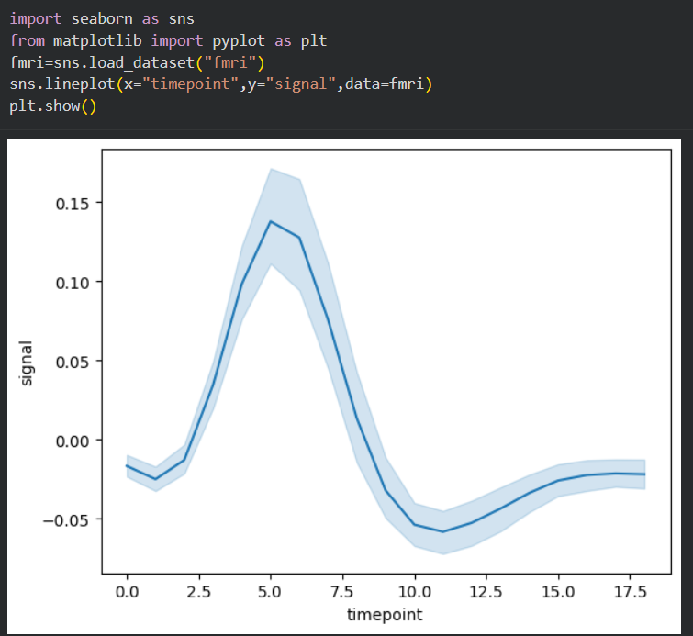
SEABORN LINE PLOT

Slide 50
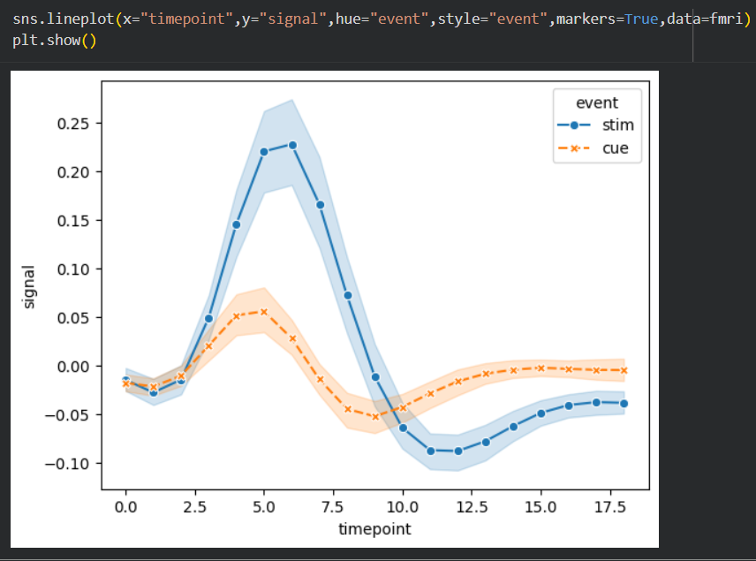
Customizing Line Plots: Hue, Style & Markers
The x-axis represents “timepoint”, and the y-axis represents “signal”
The hue="event" parameter separates the lines by different events, using distinct colors
The style="event" parameter changes the line style (solid, dashed, etc.) for each event
The markers=True option adds markers at each data point to improve readability

Slide 51
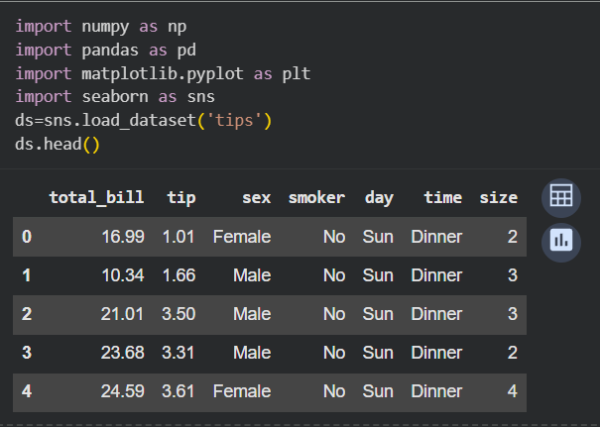
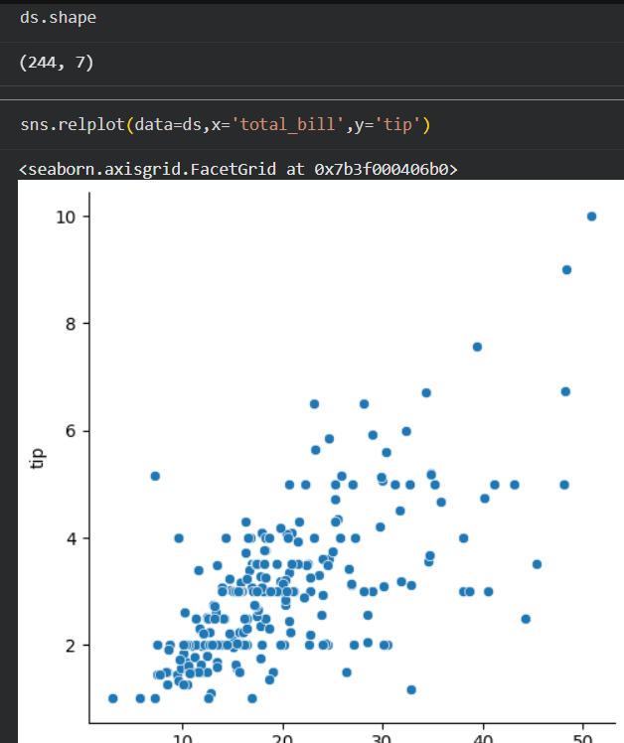
IMPORTING TIPS DATASET
scatter plot showing the relationship between the total bill and the tip

Slide 52
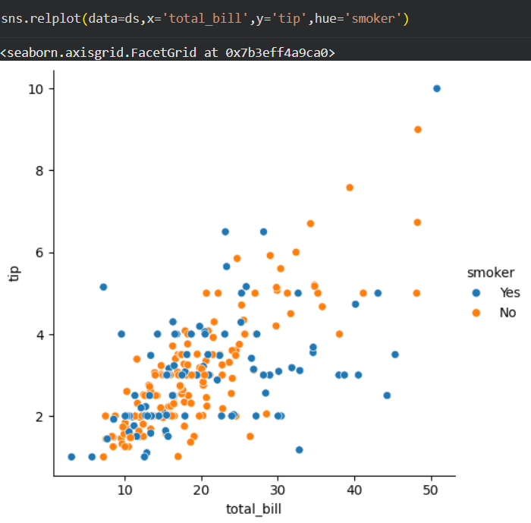
Scatter Plot with Hue Parameter

Slide 53
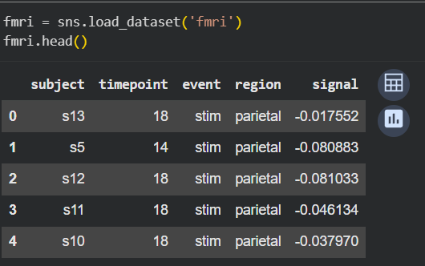
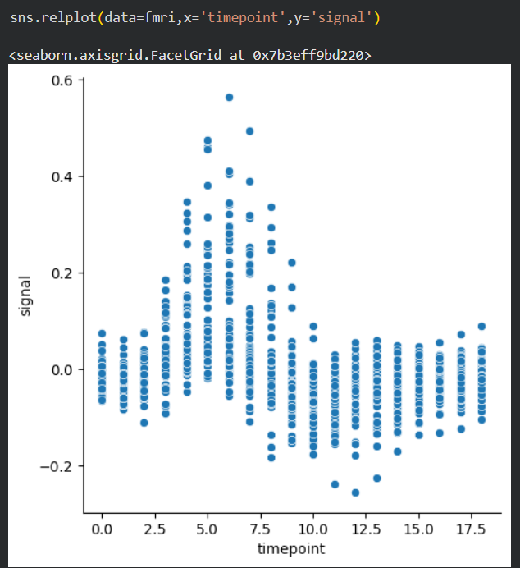

IMPORTING FMRI DATASET

Slide 54
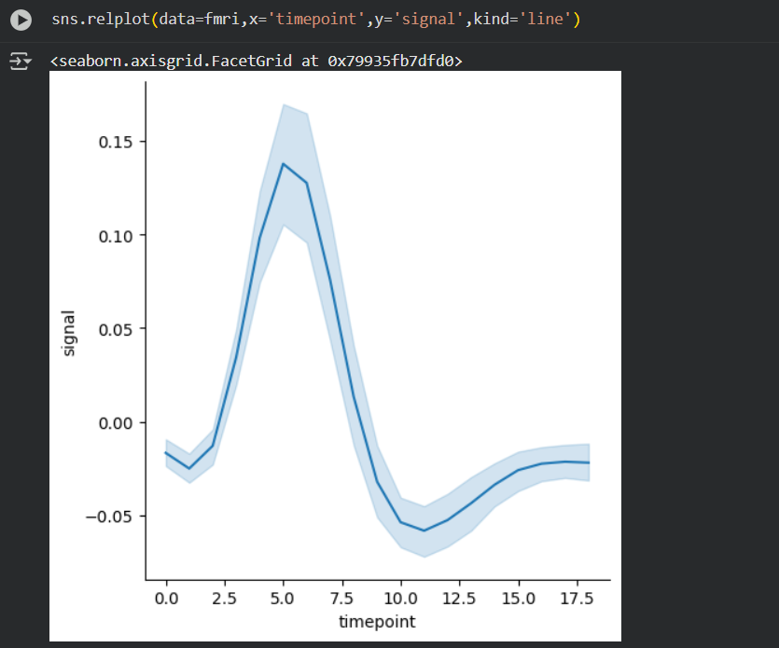
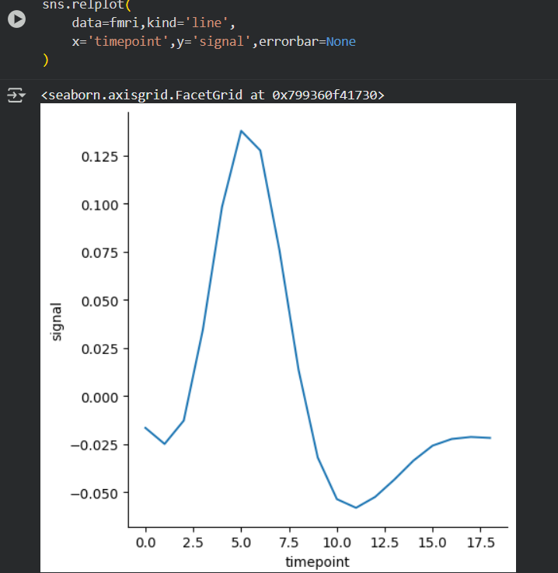

Slide 55
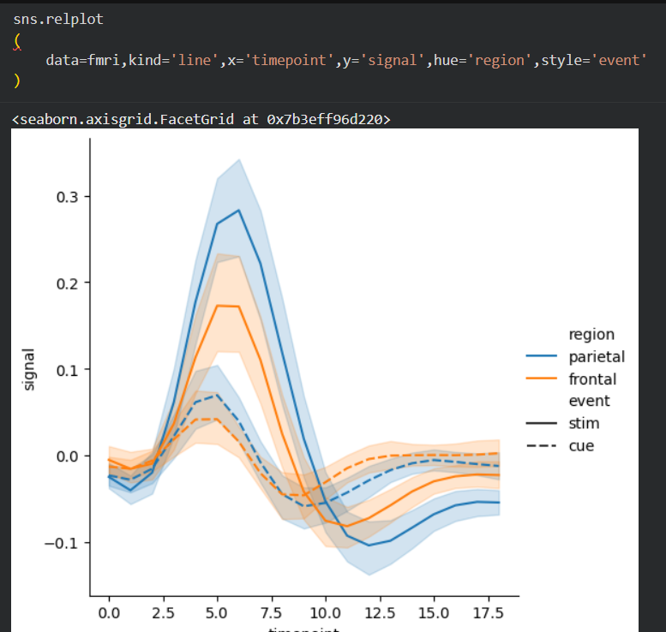
Line Plot with Multiple Categories using Hue and Style

Slide 56
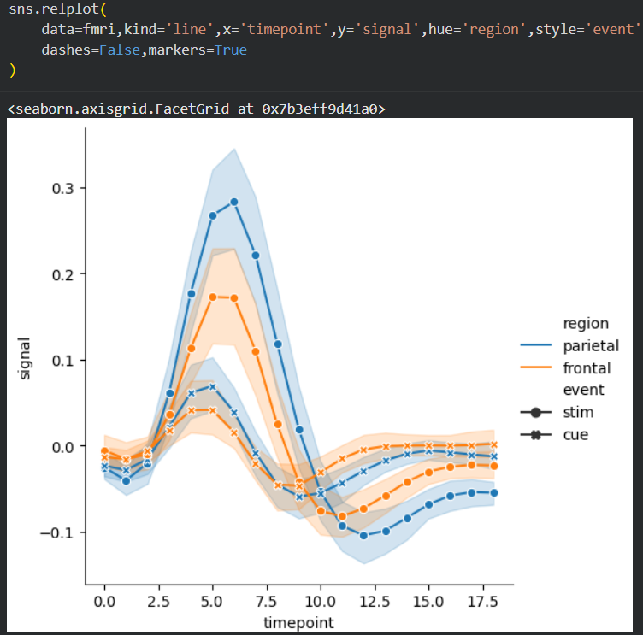
Line Plot with Markers and Continuous Lines using Hue and Style

Slide 57
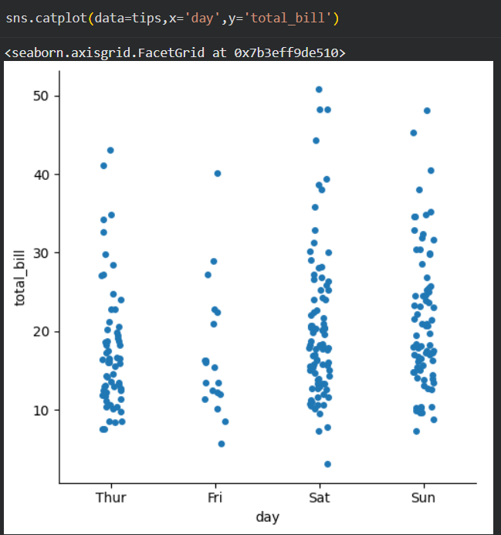
CATEGORICAL SCATTER PLOT
These categorical plots help us compare categories, detect patterns, and understand distributions across different groups

Slide 58
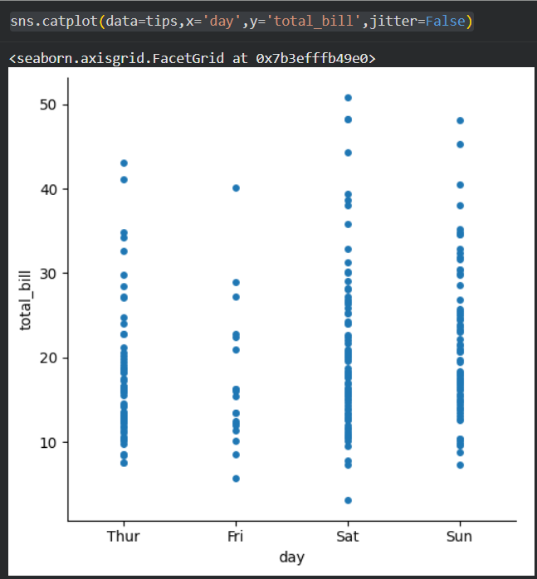
Categorical Scatter Plot without Jitter using Seaborn

Slide 59
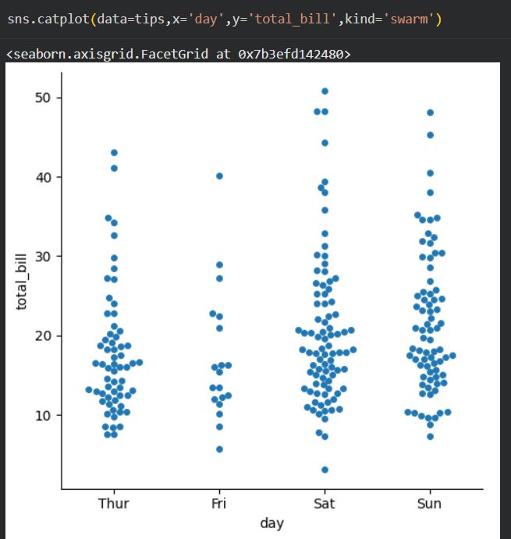
Swarm Plot for Visualizing Total Bills Across Days

Slide 60

ADDING HUE SEMATIC

Slide 61

Categorical Plot with Custom Order of Categories

Slide 62

Categorical plot on vertical axis

Slide 63

BOX PLOT Represntation

Slide 64

VIOLIN PLOT Representation

Slide 65

Violin Plot with Split Hue for Gender-wise Comparison of Total Bills

Slide 66
CONCLUSION
During this internship, I gained valuable insights into Artificial Intelligence and Machine Learning, along with hands-on experience using Python libraries such as NumPy, Pandas, Matplotlib, and Seaborn.
These sessions helped me understand the process of data handling, visualization, and analysis — skills that will be extremely useful for my project, BudgetWise: AI-based Expense Forecasting Tool.
I would like to express my sincere gratitude to Infosys Springboard for providing this learning opportunity and to my mentor Sangeetha Mam for her continuous guidance and support during
this internship period.
THANK YOU
GORLE AJAY
AI Domain Intern | BudgetWise Project

